Slide 1
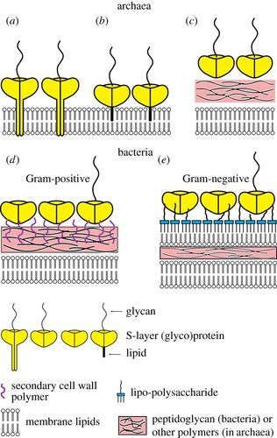

Slide 2
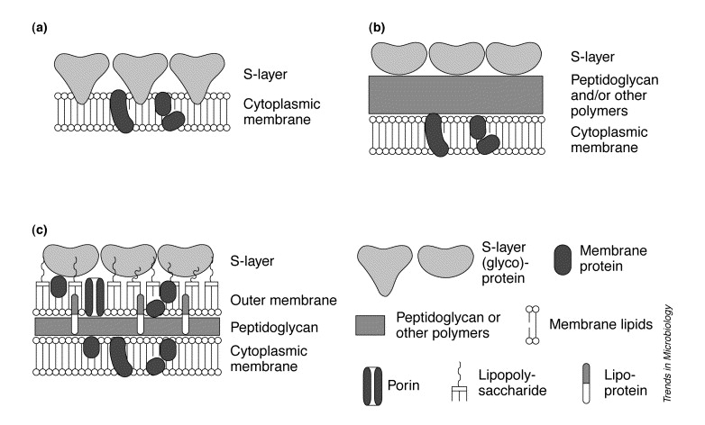

Slide 3
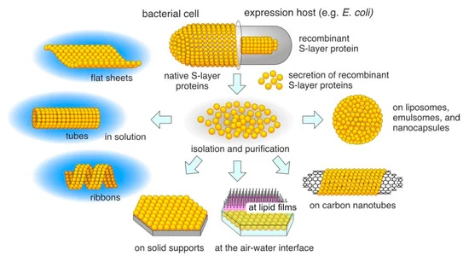

Slide 4
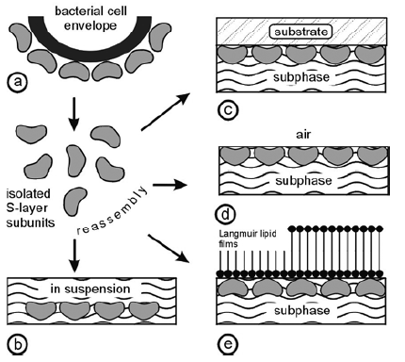
Self Assembly
Figure (a) Schematic illustration of the recrystallization of isolated S-layer subunits into crystalline arrays. The self assembly process can occur in suspension (b), on solid supports (c), at the air/water interface (d), and on Langmuir lipid films (e). (Reproduced from Ref. [3], with permission from Wiley-VCH.)

Slide 5
Self-Assembly in Suspension
S-layers have ability to reassemble into two-dimensional arrays after removal of the disrupting agent
High-resolution electron microscopical studies showed, crystal growth is initiated simultaneously at many randomly distributed nucleation points and proceeds in-plane until the crystalline domains meet, thus leading to a closed, coherent mosaic of individual several micrometer large S-layer domains
Formation of these self-assembled arrays is only determined by the amino-acid sequence of the polypeptide chains and, consequently, the tertiary structure of the S-layer protein species.
The self-assembly products may have the form of flat sheets, open-ended cylinders or closed vesicles.
The shape and size of the self-assembly products depends strongly on the environmental parameters during crystallization such as temperature, pH, ion composition, and/or ionic strength.

Slide 6
Recrystallization at Solid Supports
Reassembly of isolated S-layer proteins can be induced on solid surfaces
Recrystallization of S-layer proteins on technologically relevant substrates such as silicon wafers, carbon-, platinum- or gold electrodes and on synthetic polymers revealed a broad application potential in micro- and nanotechnology
Formation of coherent crystalline arrays depends on
S-layer protein species
Environmental conditions of the bulk phase
Surface properties of the substrate.

Slide 7
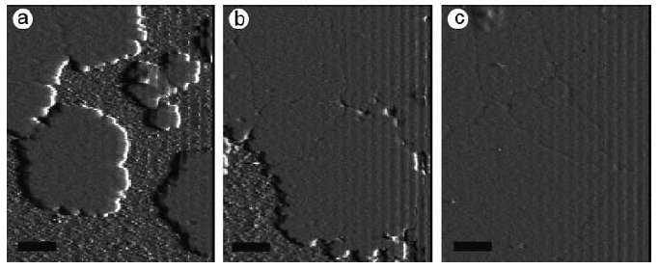
Recrystallization at Solid Supports
Figure: Recrystallization of the S-layer protein SbpA of Bacillus sphaericus CCM 2177 on a hydrophilic silicon wafer. The atomic force microscopical images show that crystal growth is initiated simultaneously at many randomly distributed nucleation points (a) and proceeds in-plane until the crystalline domains meet (b), thus leading to a closed, coherent mosaic of individual several micrometer large S-layer domains (c). Scale bars = 0.5 mm; Z-range = 12 nm. (Figure courtesy of E. Györvary and O. Stein.)

Slide 8
Langmuir-Blodgett (LB) films are prepared by transferring floating organic monolayers onto solid substrates.
A combination of innovative chemistry and a carefully engineered instrument (a Langmuir trough) can result in high quality monomolecular assemblies displaying a high degree of structural order.
The technique was first reported about fifty years ago and since then, LB films have been widely used as model systems in fundamental research.
However, it is only during the past decade that the extensive applied potential has been recognised.
Their precise thickness, coupled with the degree of control over the molecular architecture, has now firmly established a role for these layers in thin film technology.
Potential applications in molecular electronics

Slide 9
Recrystallization at the Air/Water Interface and on Langmuir Lipid Films
It is easy and reproducible way to generate coherent S-layer lattices on a large scale.
The orientation of the protein arrays at liquid interfaces is determined by the anisotropy in the physico-chemical surface properties of the protein lattice.
Electron microscopical examinations revealed, recrystallized S-layers were oriented with
Their outer charge neutral, more hydrophobic face against the air/water interface
Negatively charged, more hydrophilic inner face against charge neutral, charged or zwitterionic headgroups of phospho- or tetraether lipid films
As with S-layer lattices recrystallized on solid surfaces, S-layer protein monolayers consist of a closed mosaic of individual monocrystalline domains.

Slide 10
Diagnostics
Studies on the structure, morphogenesis, genetics, and function of S-layers revealed that
S-Layer iso-porous monomolecular arrays have a considerable application potential in biotechnology, molecular nanotechnology, and biomimetics.
The repetitive features of S-layers have led to their applications in S-layer ultrafiltration membranes (SUMs)
Supports for a defined covalent attachment of functional molecules e.g.
Enzymes, antibodies, antigens, protein A, biotin, and avidin
Required for affinity and enzyme membranes, in the development of solid-phase immunoassays, or in biosensors

Slide 11
SUM-based dipsticks
In dipstick-style solid-phase immunoassays, the respective monoclonal antibody was covalently bound to the carbodiimide-activated carboxylic acid groups of the S-layer lattice
Proof of principle demonstrated for different types of SUM-based dipsticks.
Diagnosis of type I allergies (determination of IgE in whole blood or serum against the major birch pollen allergen Bet v1),
Quantification of tissue type plasminogen activator (t-PA) in patients’ whole blood or plasma
Monitoring t-PA levels during the course of thrombolytic therapies after myocardial infarction
Determination of interleukin 8 (IL-8) in the supernatants of human umbilical vein endothelial cells induced with lipopolysaccharides

Slide 12
Chimeric S-layer fusion proteins
Chimeric S-layer fusion proteins are genetically constructed by incorporating biologically active sequences without hindering the self-assembly of S-layer subunits
Chimeric S-layer proteins rSbsC₃₁₋₉₂₀/Bet v1 and rSbpA₃₁₋₁₀₆₈/Bet v1 carrying the major birch pollen allergen Bet v1 at the C-terminal end, the surface location and functionality of the fused allergen was demonstrated by binding Bet v1-specific IgE.
These fusion proteins can be used for building up arrays for diagnostic test systems to determine the concentration of Bet v1-specific IgE in patients’ whole blood, plasma, or serum samples.
To build up functional monomolecular S-layer protein lattices on solid supports (e. g., gold, silicon, or glass), the surface must be functionalized with covalently attached chemically modified SCWP, to which the S-layer fusion proteins bind with their N-terminal part, leaving the C-terminal part with the fused functional sequence exposed to the ambient environment.

Slide 13
Label-free detection systems
Using streptavidin–biotin interaction as a biomolecular coupling system, S-layer-streptavidin fusion proteins were constructed
The chimeric S-layer, a feasible tool to arrange different biotinylated targets (e. g., proteins, allergens, antibodies, or oligonucleotides) on a surface which will find application in protein, allergy, or DNA-chip technology, highly integrated diagnostic devices (Lab-on-Chip).
Another application is in the development of label-free detection systems,
In SPR or surface acoustic wave technique, specific binding of functional molecules (e. g., proteins or antibodies) to the sensor chip functionalized with an oriented chimeric S-layer can be visualized directly by a mass increase on the chip without the need for any labeled compound.
Thus, a functional S-layer fusion protein recrystallized in defined orientation on SCWP-coated solid supports allow the development of new label-free detection systems as required for biochip technology.

Slide 14
Lipid Chips: Stabilization of bilayer lipid membranes (BLMs)
Free-standing bilayer lipid membranes (BLMs) survive for only minutes to hours and sensitive toward vibration and mechanical shocks
Stabilization of BLMs is necessary to utilize the function of cell membrane components for practical applications (e. g., as lipid chips).
S-layer proteins can be exploited as supporting structures for BLMs since they stabilize lipid film and retain their physical features (e. g., thickness, fluidity)
Lipid membranes attached to a porous support combine the advantage of possessing an essentially unlimited ionic reservoir on each side of the lipid membrane and of easy manual handling

Slide 15
SUM-supported bilayers
A new strategy is application of SUM with the S-layer as stabilizing and biochemical layer between the BLM and the porous support.
SUMs are iso-porous structures with sharp molecular exclusion limits
SUM are manufactured by depositing S-layer-carrying cell wall fragments under high pressure on commercial microfiltration membranes (MFMs) with pore size of ~ 0.4 mm
After deposition, the S-layer lattices are chemically crosslinked to form a coherent smooth surface ideal for depositing lipid membranes.
Composite SUM-supported bilayers (Figure) are tight structures with breakdown voltages well above 500 mV during their whole life-time of 8 ~ hours
For a comparison, lipid membranes on a plain nylon MFM have a life-time of 3 hours, ruptured at breakdown voltages ~ 210 mV.

Slide 16
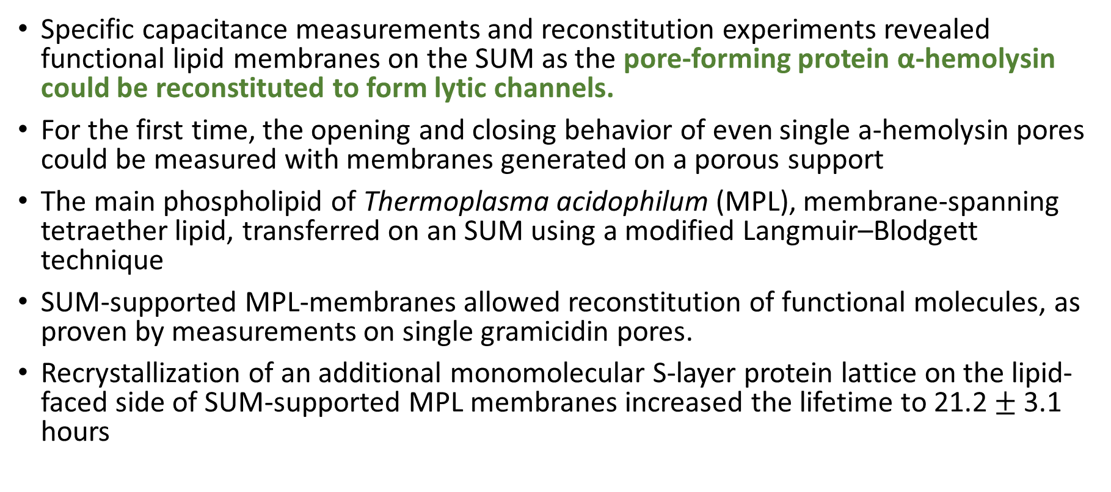
SUM-supported bilayers
Specific capacitance measurements and reconstitution experiments revealed functional lipid membranes on the SUM as the pore-forming protein α-hemolysin could be reconstituted to form lytic channels.
For the first time, the opening and closing behavior of even single a-hemolysin pores could be measured with membranes generated on a porous support
The main phospholipid of Thermoplasma acidophilum (MPL), membrane-spanning tetraether lipid, transferred on an SUM using a modified Langmuir–Blodgett technique
SUM-supported MPL-membranes allowed reconstitution of functional molecules, as proven by measurements on single gramicidin pores.
Recrystallization of an additional monomolecular S-layer protein lattice on the lipid-faced side of SUM-supported MPL membranes increased the lifetime to 21.2$±$ 3.1 hours

Slide 17
Solid-supported lipid membranes
Solid-supported membranes (Figure D) were developed to
overcome fragility of free-standing BLMs
to enable biofunctionalization of inorganic solids (e. g., semiconductors, gold-covered surfaces) for use in sensing devices e.g., lipid chips.
Solid-supported lipid membranes often show drawbacks
there is a limited ionic reservoir at the side facing the solid support
the membranes often appear to be leaky (non-insulating),
large domains, protruding from the membrane, may become denatured by the inorganic support
Here also, S-layer proteins have potential as stabilizing, separating ultrathin layer and maintains structural and dynamic properties of the lipid membranes.
Silicon substrates covered by closed S-layer lattice and bilayers were deposited by Langmuir–Blodgett technique

Slide 18
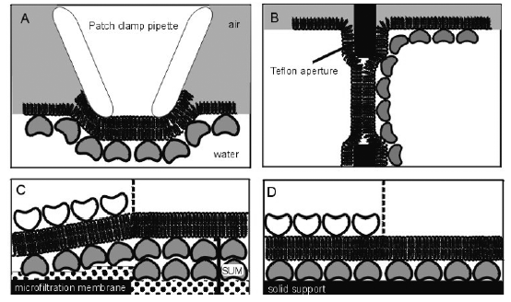
Figure: Schematic illustrations of various S layer- supported lipid membranes. (A) Bilayer lipid membranes (BLMs) have been generated across an aperture of a patch–clamp pipette using the Tip-Dip method, and a closed S-layer has been recrystallized from the aqueous subphase. (B) A folded membrane has been generated to span a Teflon aperture using the method of Montal and Mueller Subsequently, S-layer protein can be injected into one or both compartments (not shown), whereby the protein self-assembles to form closely attached S-layer lattices on the BLMs. (C) On an S-layer ultrafiltration membrane (SUM) a BLM can be generated by a modified Langmuir–Blodgett (LB) technique. As a further option, a closed S-layer lattice can be attached on the external side of the SUM-supported BLM (left part). (D) Solid supports can be covered by a closed S-layer lattice, and subsequently BLMs can be generated using combinations of the LB and Langmuir–Schaefer techniques, and vesicle fusion. As shown in (C), a closed S-layer lattice can be recrystallized on the external side of the solid supported BLM (left part).

Slide 19
S layer- supported lipid membranes
Lateral diffusion of fluorescently labeled lipid molecules in both layers, investigated by fluorescence recovery after photobleaching studies
In comparison with hybrid lipid bilayers (lipid monolayer on alkyl silanes) and lipid bilayers on dextran, the mobility of lipids was highest in S-layer-supported bilayers.
S-layer cover prevent the formation of cracks and inhomogeneities in the bilayer
Concluding, the biomimetic approach of copying the supramolecular architecture of archaeal cell envelopes opens new possibilities for exploiting functional lipid membranes at meso- and macroscopic scale.
It has potential to initiate a broad spectrum of lipid chips applicable for sensor technology, diagnostics, electronic or optical devices, and high-throughput screening for drug discovery.

